Slide 1


Who Wants to
Be a Millionaire?
Notes:
Lifeline icons on the question slides are hyperlinks which will take you to the lifeline screen. To return to the game, you may right click on the screen, choose Go, Previously Viewed. This should return you to the question slide. Alternatively, left click as usual to return to the game board, then click on the highest number that has been previously selected (in gold to indicate a followed hyperlink).
To utilize the 50:50 option, the moderator may tell the contestant which two options to disregard or, use Control-P to change the mouse arrow to a pen. Draw a line through two incorrect responses, then use Control-A to change the pen back into an arrow and continue with the game.
Clicking on the action button on the phone handset image of the Phone a Friend lifeline slide will hyperlink to the Ask Jeeves web site where the participant may ask for help.

Slide 2



1,000,000
500,000
250,000
125,000
64,000
32,000
16,000
8,000
4,000
2,000
1,000
500
300
200
100

Slide 3


Click to return to question, Cont-P to switch to the pen, cross out two incorrect answers, then Cont-A to switch back to pointer.

Slide 4

Click to return to the question and poll the class

Slide 5
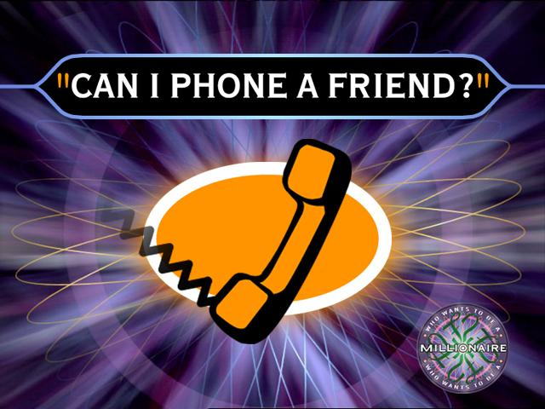
Click on link to Ask Jeeves, or click on this oval to return to question and ask a friend

Slide 6
What song does Beyonce sing
A. Diva
B. Love game
C. Poker face
D.Im on a Boat

Slide 7
A. Well Done
Back to Board

Slide 8
What song does Alesha Dixon sing?
To the left
B. La La Land
C. breath slowly
D. Rock star

Slide 9
C. Good Job
Back to Board

Slide 10
Who sing kiss kiss with chris brown?
A. Kanye west
B.T pain
C. Neyo
D.Cira

Slide 11
B. Well Done
Back to Board

Slide 12
How old is Taylor Swift?
A. 19
B. 18
C. 13
D. 16

Slide 13
A. Good Job
Back to Board

Slide 14
What country does chris brown come from?
A. New zealand
B. lil wayne
C. USA
D. Kanye west

Slide 15
C. Good job
Back to Board

Slide 16
What song does keri hillson
A. wall to wall
B. knock you down
C. love story
D. Brother

Slide 17
B. Well done
Back to Board

Slide 18
What’s Beyonce’s sisters name
A. Taylor swift
B. hilary duff
C. Solage
D. Rihanna

Slide 19
C. Well done
Back to Board

Slide 20
Who sings thinking about you?
A. Diva
B. love game
C. poker face
D. house of shem

Slide 21
D. Nice one
Back to Board

Slide 22
What color is leona lewis’s eyes
A. Blue
Green
C. Black
D. brown

Slide 23
B. Good job
Back to Board

Slide 24
What is Chris brown’s favorite colour?
A. Purple
B. green
C.Yellow
D.Blue

Slide 25
A. Well done
Back to Board

Slide 26
What song does bob marley sing ?
A. jai ho
B. night shift
C. poker face
D.la la land

Slide 27
B. Well done
Back to Board

Slide 28
Who sang in Justin timberlake’s latest song?
A.lil wayne
B. neyo
C Ciara
D. rihanna

Slide 29
C. Good on you
Back to Board

Slide 30
What is hilarys Duff Big sisters name?
A. Tim
B. Sophie
C. Tasha
D. haylie

Slide 31
D. Good job
Back to Board

Slide 32
What is rihanna real name?
A. Robyn
B.lady ga ga
C. ashley
D. jam jam

Slide 33
A. Yeah

Slide 34
Sorry, try again!

Slide 35
Thanks for playing!

